Slide 1
Chem 108: Class/ Lab
Week 13
Pick a vial and a plastic dropper
Using the vial number, sign-in on the Lab roster
Pick up HANDOUTS
Fluid Exchange Form & Post Lab
(Handout)
2) Acid-Bases: pH
(Handout)

Slide 2
Chem 108: Class/ Lab
Week 13: 2019f
Do Today:
1) Fluid Exchange (Handout)
Due Next Lab
2) Acid-Base: pH (Handout)
Data completed & signed before leaving Lab
Follow Instructions
http://chemconnections.org/general/chem120/fluid-ex.108.html

Slide 3
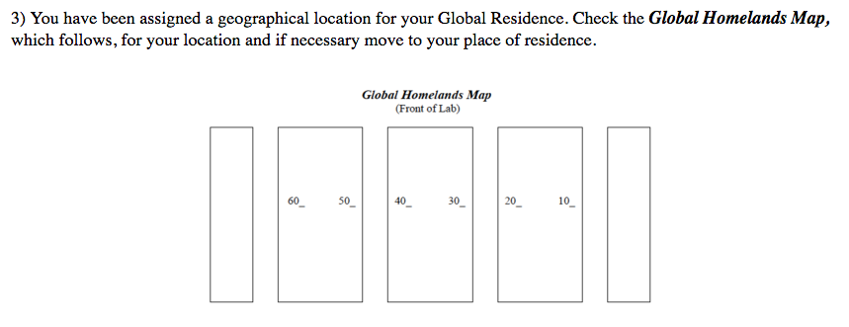
Chem 108: Class/ Lab
Week 13
TODAY:
Fluid Exchange (Handout)
http://chemconnections.org/general/chem120/fluid-ex.108.html
Wait for Dr. R's instructions on exchanging fluids, keeping records, and using the handout provided.

Slide 4
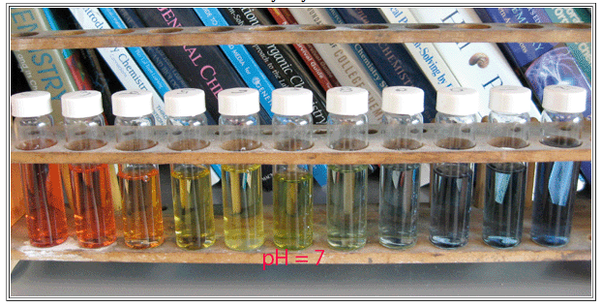
Acid-Base Indicators
<7 ACIDIC
Neutral
>7 BASIC

Slide 5
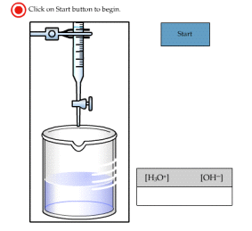
Water as an Acid and a Base
Self-ionization
http://chemconnections.org/general/movies/KwActivity.swf

Slide 6
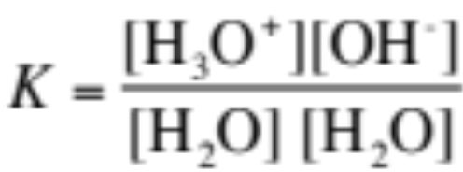
Pure Water is an Acid and a Base
It is amphoteric. (It can behave either as an acid or a base).
H₂O + H₂O  H₃O⁺ + OH⁻
conj conj
  acid 1 base 2 acid 2 base 1
K_{w} = 1 × 10⁻¹⁴ at 25°C
K_{w} = [H₃O⁺ ][OH⁻] = [1 × 10⁻⁷M][1 × 10⁻⁷M]
NOTE: only concentrations [mol/L] are used in the calculation;
liquids (l) and solids (s) are not included

Slide 7
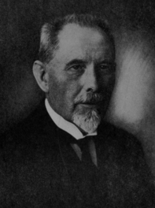
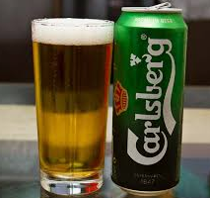
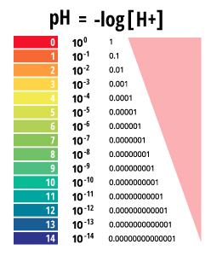
The pH Scale
https://phet.colorado.edu/en/simulation/ph-scale-basics
pH: the negative logarithm
of the
hydrogen ion concentration.
Quantitative, logarithmic, numeric scale based on testing the electric current of aqueous solutions & relating it to the equilibrium concentration of the hydrogen ion,
[H⁺_{(aq)} ]= [H₃O⁺_{(aq)}]
Introduced in 1909 by Søren Sørensen, Danish brewer/chemist, as a convenient way of expressing acidity……. Providing much improved quality control in brewing.
Beer’s pH ~ 4
http://www.chemconnections.org/general/chem108/Acids-Bases%20Guide.html

Slide 8
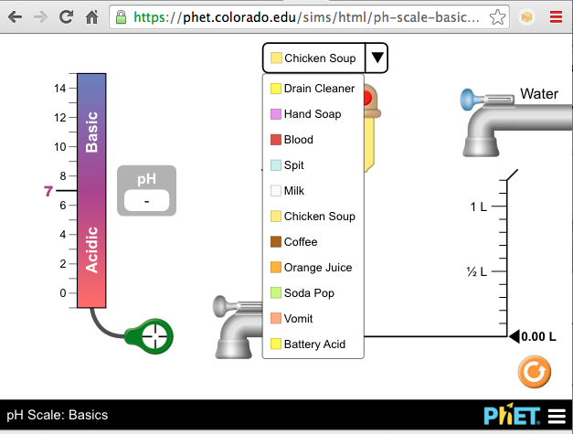
The pH Scale
pH ≈ −log[H⁺] ≈ −log[H₃O⁺]
pH in water ranges from 0 to 14.
K_{w} = 1.00 × 10⁻¹⁴ = [H⁺] [OH⁻]
pK_{w} = 14.00 = pH + pOH
As pH rises, pOH falls (sum = 14.00).
There are no theoretical limits on the values of pH or pOH. (e.g. pH of 2.0 M HCl is -0.301)
https://phet.colorado.edu/en/simulation/ph-scale-basics

Slide 9
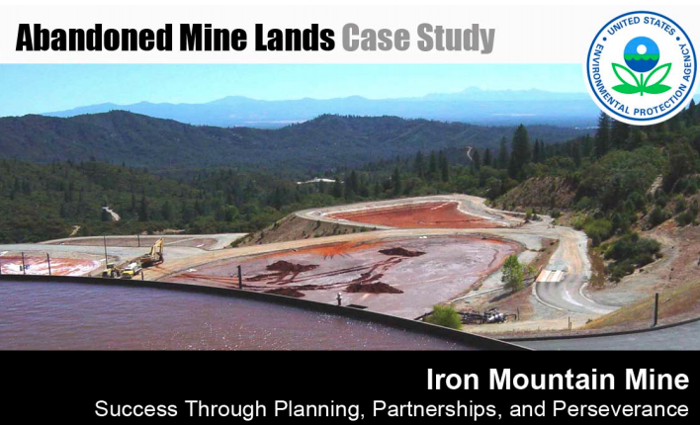
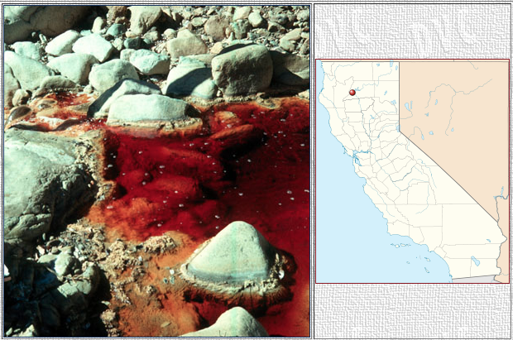
The pH Scale
The drainage water from the Iron Mountain Mine is the most acidic water on Earth; some samples collected in 1990 and 1991 have been measured to have a pH value of -3.6, which is the lowest pH observed globally in a natural environment.
Notes:
Iron Mountain Mine, also known as the Richmond Mine at Iron Mountain, is a mine near Redding in Northern California. Geologically classified as a "massive sulfide ore deposit", the site was mined for iron, silver, gold, copper, zinc, and pyrite intermittently from the 1860s until 1963. The mine is the source of extremely acidic mine drainage which also contains large amounts of zinc, copper and cadmium. One of America's most toxic waste sites, it has been listed as a federal Superfund site since 1983.
The drainage water from the Iron Mountain Mine is the most acidic water on Earth; some samples collected in 1990 and 1991 have been measured to have a pH value of -3.6, which is the lowest pH observed globally in an natural environment.
When pyrite is exposed to moisture and oxygen, sulfuric acid forms. This sulfuric acid runs through the mountain and leaches out copper, cadmium, zinc, and other heavy metals. This acid flows out of the seeps and portals of the mine. Much of the acidic mine drainage ultimately is channeled into the Spring Creek Reservoir by creeks surrounding the mine. The low pH level and the heavy metal contamination from the mine have caused the virtual elimination of aquatic life in sections of Slickrock Creek, Boulder Creek, and Spring Creek.
The mine was designated a Superfund site in 1983 and a water treatment plant was built in 1994. In 2000 the government reached a settlement with the responsible parties for the long-term funding of the cleanup efforts, which will require ~ 1 billion dollars.

Slide 10
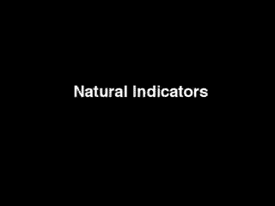
Indicators

Slide 11
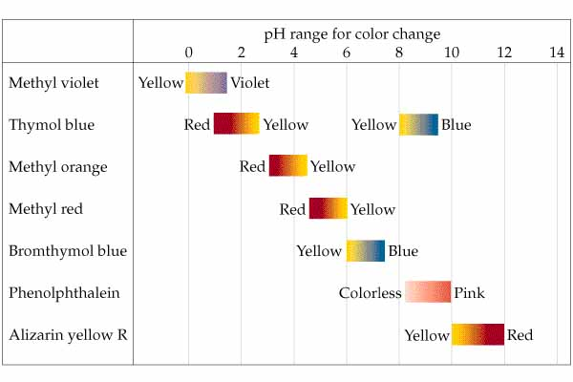
Acid-Base Indicators

Slide 12
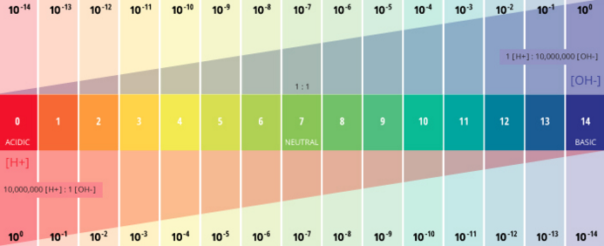
= -log [H₃O⁺]

Slide 13
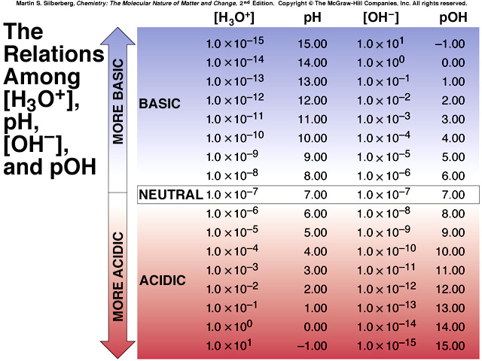

Slide 14
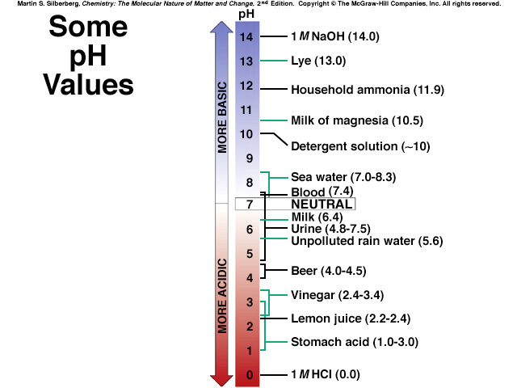
The pH Values of Some Familiar
Aqueous Solutions
Th pH Values of Some Familiar
Aqueous Solutions
(TODAY’S LAB EXPERIMENT)
[H₃O⁺]
K_{W}
[OH⁻] =
[H₃O⁺]
[OH⁻]
[H₃O⁺]>
[OH⁻]
[H₃O⁺]<
[OH⁻]
acidic
solution
neutral
solution
basic
solution
[H₃O⁺] =
[OH⁻]

Slide 15
Chem 108: Class/ Lab
Week 13
Fluid Exchange
(Handout) Due Next Lab
TODAY:
2) Acid-Base: pH (Handout)
Data table completed & signed before leaving Lab
Due Next Week:
Fully Completed Handout plus On-line Questions
http://chemconnections.org/general/chem108/Acids-Bases%20Guide.html

Slide 16
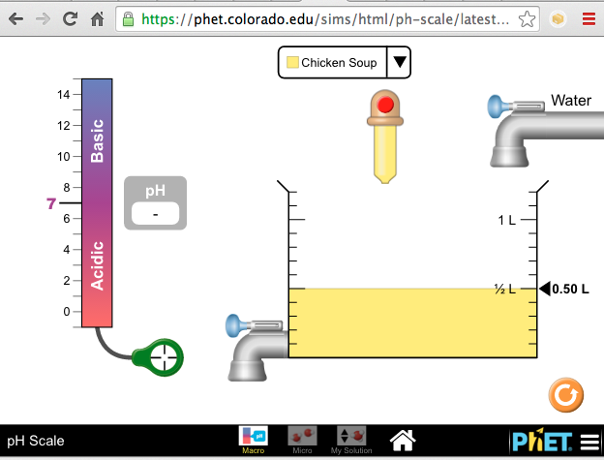
Acid-Base Strengths pH [indicator paper & pH meter]
https://phet.colorado.edu/en/simulation/ph-scale
Strong Acid:
Strong Base:
Weak Acid:
Weak Base:
http://www.chemconnections.org/general/chem108/Acids-Bases%20Guide.html

Slide 17
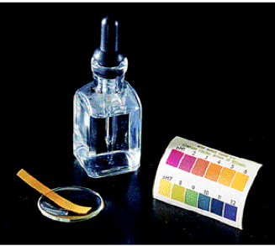
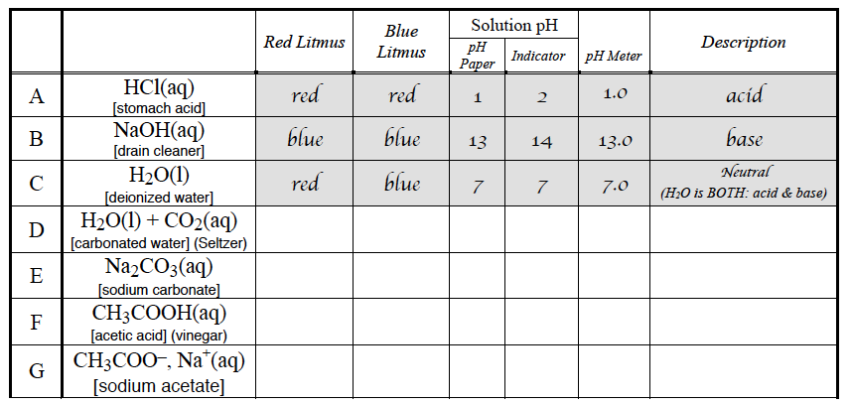
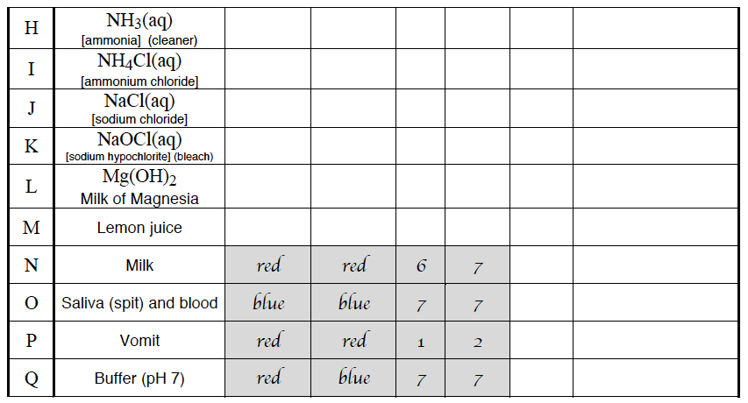
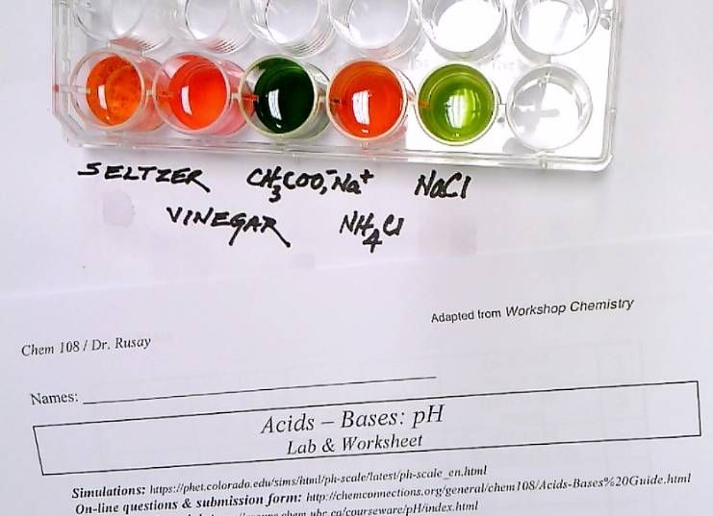

Slide 18
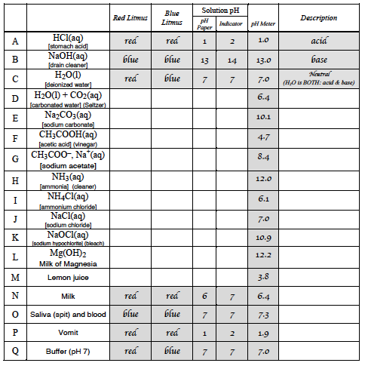
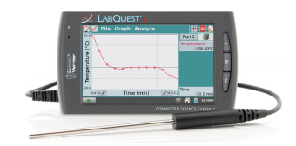
Lab pH: pH Meter

Slide 19
Chem 108: Class/ Lab
Week 13
Fluid Exchange
(Handout) Due Next Lab
TODAY:
2) Acid-Base: pH (Handout)
Show Dr. R your well plate with test solutions and indicator, and your completed data table, which corresponds to the wells; to be signed before leaving Lab
Due Next Week:
Fully Completed Handout plus On-line Questions
http://chemconnections.org/general/chem108/Acids-Bases%20Guide.html

